Slide 1


Predicting Data-Related Annual Job Salary and Title from Job-Posting
Project 4

Slide 2

Project Objectives
Identify factors that predict data-related role annual salaries
Identify what distinguishes between data-related job categories/titles

Slide 3




General approach to project
Web scrape Job Listings
Natural Language Processing
Modelling (Regression and Classification)
Findings and Conclusion

Slide 4


Job listing sourced from indeed.
Key Libraries Used for Web Scraping and Extraction
Requests
BeautifulSoup
Job Search Criteria:
Australia is the designated search location: selected as locally appropriate to client needs
Search terms selected:
'research+scientist', ‘
data+scientist’,
'machine+learning+engineer’,
'data+analyst'
Search Results
'research+scientist’
‘Total jobs': 274
'Pages to Search': 5
'data+scientist’
'Total jobs': 638
'Pages to Search': 11
'machine+learning+engineer':
'Total jobs': 382
'Pages to Search': 7
'data+analyst'
'Total jobs': 3135
'Pages to Search': 20
TOTAL JOBS = 2357
WITH SALARY = 493

Slide 5
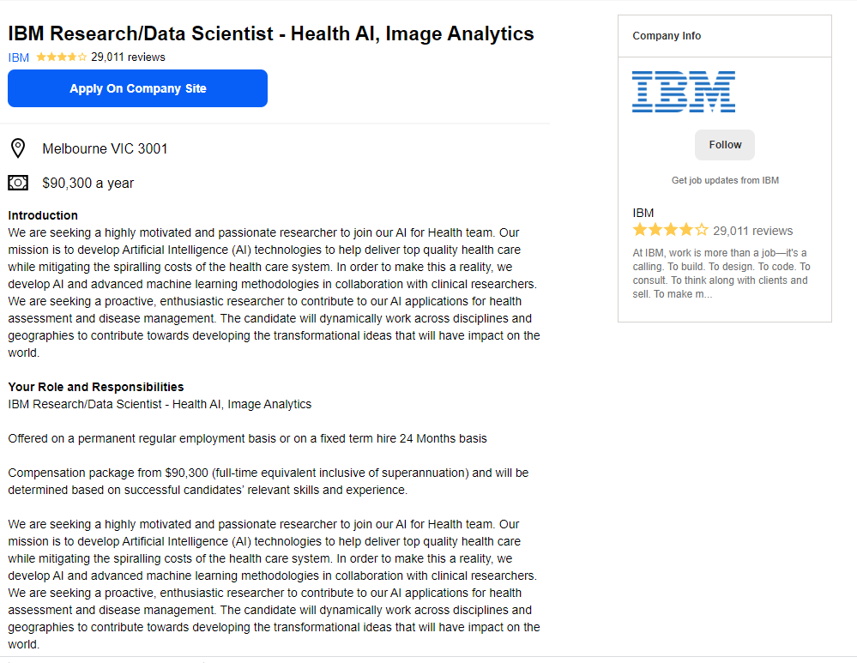
Job Title <‘h3’>
Company
'div’ 'class': 'icl-u-lg-mr--sm icl-u-xs-mr--xs'
Location
'span’ 'class': 'jobsearch-JobMetadataHeader-iconLabel'
Salary
'span’ 'class': 'jobsearch-JobMetadataHeader-iconLabel'
Description
'div',{'id': 'jobDescriptionText'
Locating HTML tags containing relevant information all in a single Job Information Frame
Job Information Frame
'div',{'class':'jobsearch-ViewJobLayout-jobDisplay icl-Grid-col icl-u-xs-span12 icl-u-lg-span7''

Slide 6
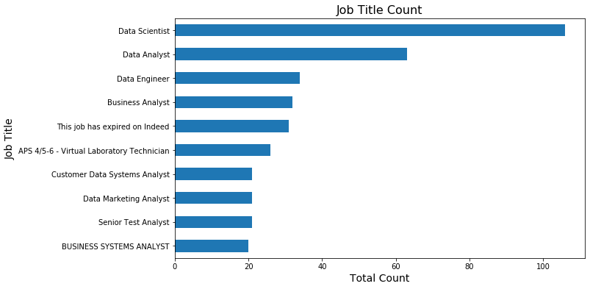
Data scientist, Data Analyst and Data Engineer were the top-3 job titles that were extracted from the job listings

Slide 7
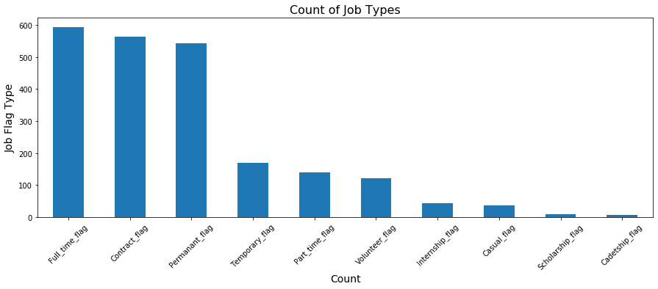
Most roles were full-time, contract, or permanent, with smaller counts for temporary and part-time positions

Slide 8
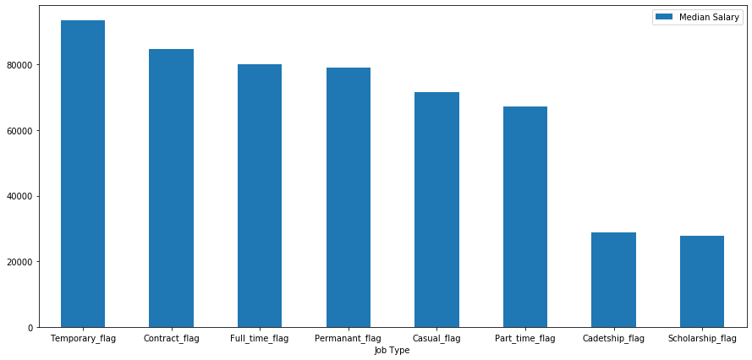
Highest median salary was for short-term positions (temp/contract), which may be compensation for lack of other benefits (e.g. job security)

Slide 9

Predicting Salary from Job Postings
Question 1

Slide 10
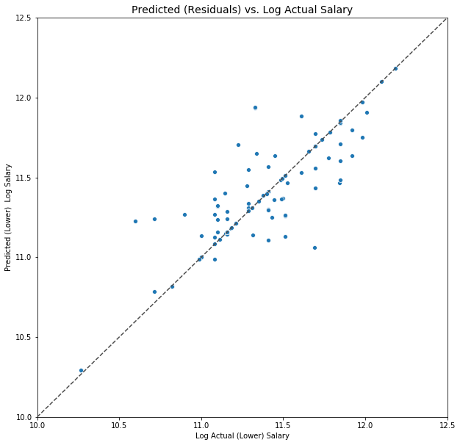
Linear Regression model did quite well in predicting (log) salary in hold out test set, with an R² value of 70.9%
Linear Regression
Residuals plot reveals no obvious issues with residuals randomly distributed around diagonal
GridSearchCV best parameters: 'tfidfvectorizer__max_df': 150, 'tfidfvectorizer__max_features': 3200, 'tfidfvectorizer__min_df': 8, 'tfidfvectorizer__ngram_range': (1, 3)

Slide 11
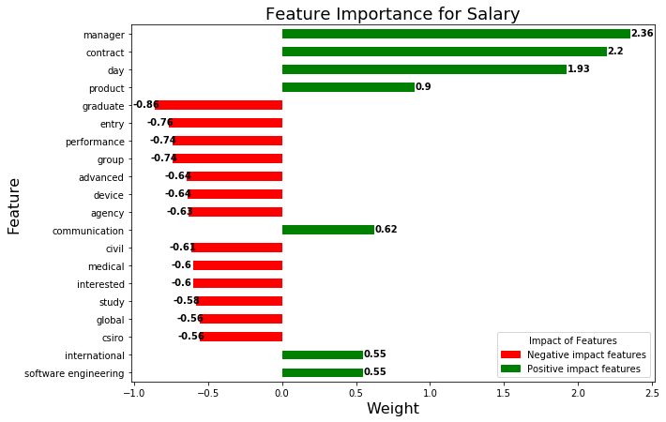
Existence of ‘Manager’ strongest positive contributions to variance explained in (log) salary with ‘graduate’ and ‘entry’ strongest negative contributions
Linear Regression
Potentially due to increased compensation for these contract positions due to loss of other benefits
These terms possible are related to research-type roles, which has a downwards impact

Slide 12
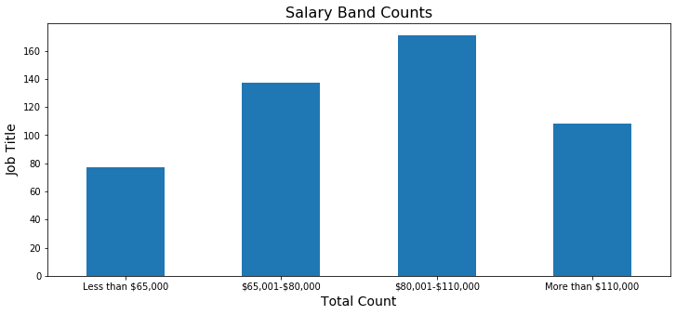




Four salary groups were used for classification approach, with most salaries falling in $80,001-$110,000 band
Less than $65,000
$65,001-$80,000
$80,001-$110,000
More than $110,000

Slide 13
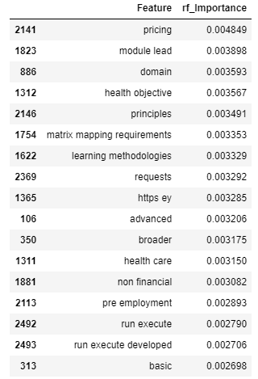
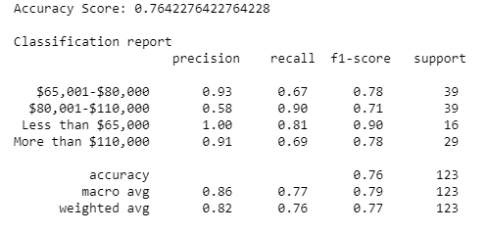
Random Forest Classifier was not very accurate (f1=0.76) with classifications in the $80,001-$110,000 range typically misclassified in classes either side. Feature importance also somewhat less interpretable

Slide 14

Distinguishing Job Types/Titles
Question 2

Slide 15
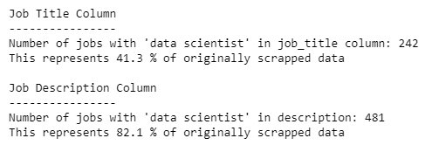
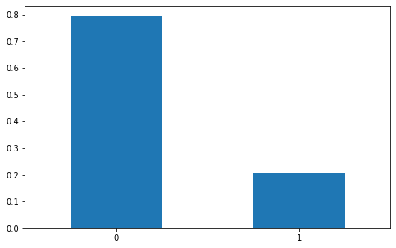
Approach to predict a simple binary classification of data science vs. non-data science roles, with target defined by whether “data scientist” in job description (not title)
Data Science Roles n = 481
Total roles n = 2324
Final targets with approximately 1 in 5 labelled as a data-scientist role
Use of description when searching results in larger number of roles identified, which will represent target
Final Target
79.30%
20.69%
Non-Data Science Role
Data Science Role

Slide 16
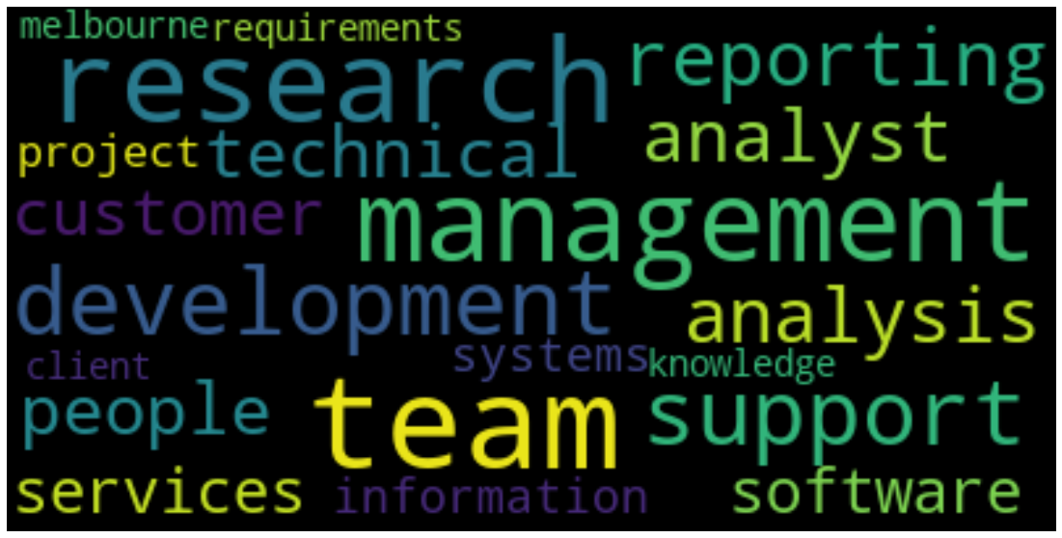
The top 20 most common top words (relative frequency) for non-data science roles included ‘team’, ‘research’ and ‘management’
‘Analysis’ implies emphasis of analysis on PAST events…
WordCloud

Slide 17
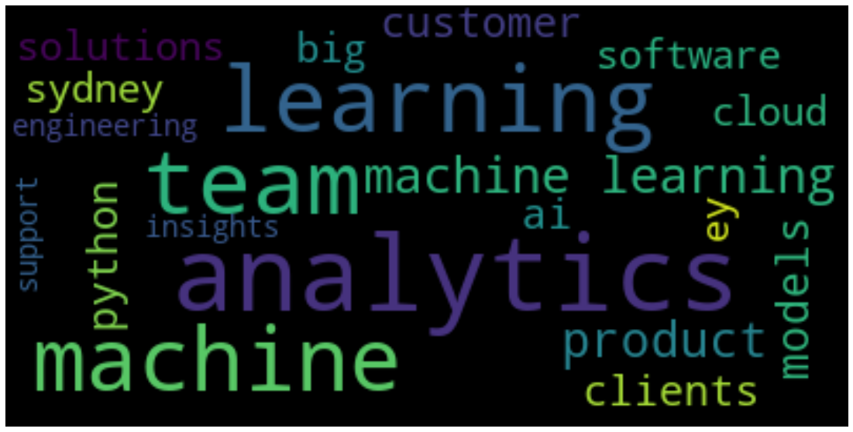
Among the most common top words (relative frequency) for data science roles included ‘analytics’, ‘learning’ and also ‘team’. Other important features included ‘ai’ and ‘python’
…‘Analytics’ though implies emphasis of analysis on FUTURE events and so the difference do make sense in terms of relative importance to both roles

Slide 18

Among logistical regression and Random Forest, the latter showed higher model performance, with an accuracy of 93.8% (vs. baseline 79.3%) and ROC score (.983)
All modelling used Cross Validation with CV=10; RandomState=42
 | LogisticRegression() | RandomForestClassifier()
Best parameters (via gridsearch) | 'logisticregression__C’: 20 'logisticregression__penalty': 'l1' | 'criterion': 'entropy’, 'max_depth': 20, 'max_features': 50
Highest Accuracy (Std) | .901 (.032) | .938 (.020)
ROC Score | .921 | .983

Slide 19
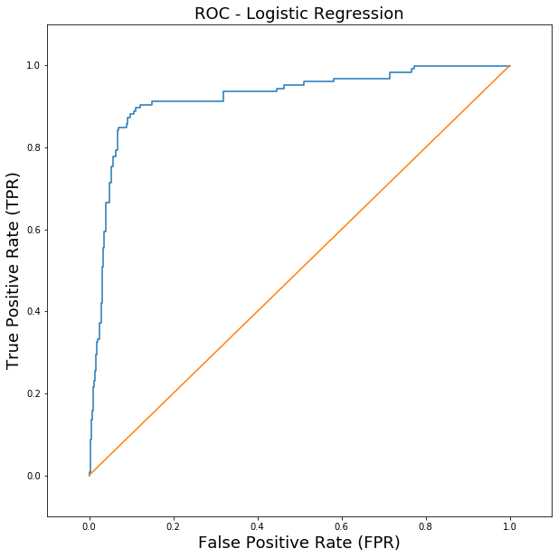
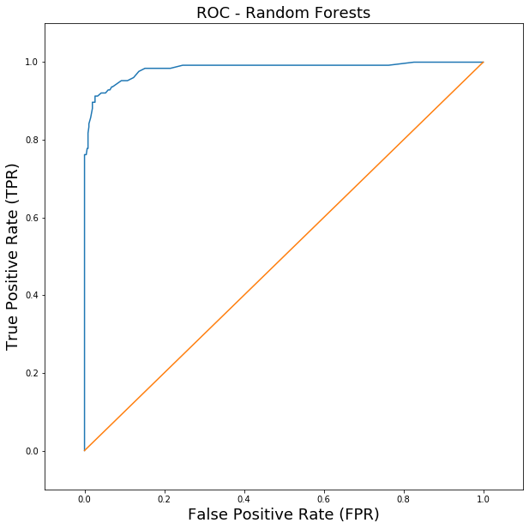
Plotting of ROC curves shows Random Forests as superior in classification of Data-science vs. Non-Data science roles
ROC Curve closer to top left corner indicating better classification for RF

Slide 20
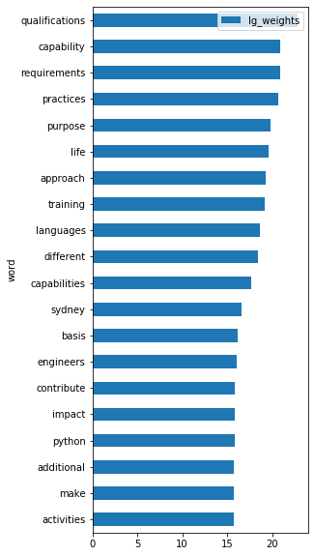
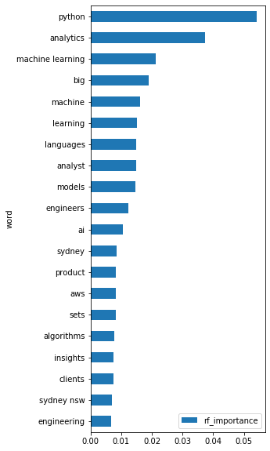
Top 20 features extracted by Random Forests are more interpretable than those identified by logistical regression with key skills and competencies (e.g. Python; machine learning; AI) relevant to data scientists being identified
Differences in features extracted possible due to imbalanced classes

Slide 21


